Slide 1
INTRODUCTION TO PROGRAMMING
Sourav Karmakar
souravkarmakar29@gmail.com

Slide 2
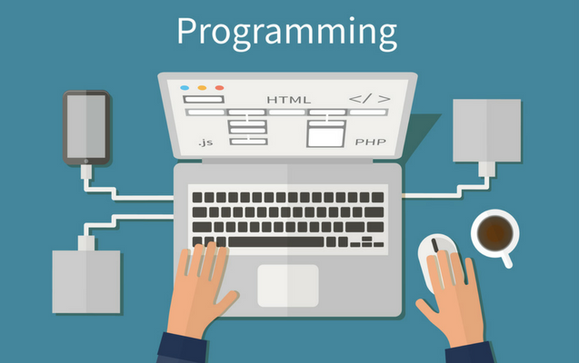
What is Programming?
Programming:
Attempting to get a computer to complete a specific task without making mistakes.

Slide 3
What is Programming?
Programming:
Attempting to get a computer to complete a specific task without making mistakes.
There has to be clear cut instructions to complete a specific task.
That set of instructions are known as program (or code)
Apart from the instructions, one also needs input data for a program to run correctly and to produce desired result.
Mistakes in a program can happen in various way:
Mistakes in instructions
Mistakes in Input Data
Mostly all kind of mistakes / errors in a program are called bugs in programming world.

Slide 4



What is Programming?
An Example
A program to take input of the marks of all the students of a particular class of a school and give the name and roll number of rankers of different subjects.
Input Data
Marks of all the students of the class
Instructions
The code to process the data and do the desired task
Output
The list of the ranker students of different subject

Slide 5
What instructions do a machine understand?
Machine (i.e. a Computer) can only understand a machine language.
As the computers are electronic devices it only can understand 1 and 0 (binary numbers)
Hence the machine language which the computer can understand comprises of only 1s and 0s
Now it is incredibly hard for a human being to write a code in machine language and to make it error-free.
So what is the solution?
Answer : The Programming Languages

Slide 6
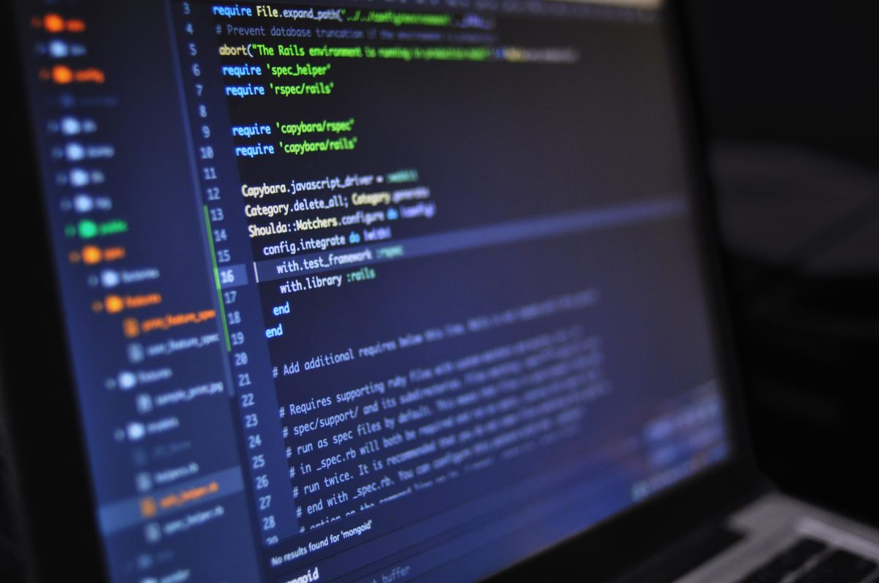
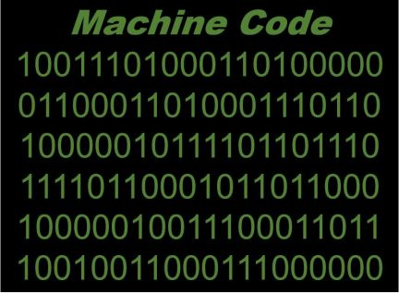

The Programming Languages
The programming languages are user friendly computer language that programmers use to write codes.
Note that computer doesn’t comprehend programming languages as well. There is an intermediate process which converts the programming language into machine readable format (i.e. machine code)
Compiler / Interpreter
Code in Programming Language
Machine Code
It is a program which converts instructions written in programming language into machine code

Slide 7
Difference Between Compiler and Interpreter?
Compiler
Interpreter
A compiler is computer software that readily translates high level programming languages into machine code. It also checks for syntactical errors in the program.
An interpreter is a computer program that converts program statements line by line into machine code. It also checks for syntactical error in program statement.
Note that both compiler and interpreter are language specific.
Difference Between Compiler and Interpreter
Basis | Compiler | Interpreter
Analysis | The entire program is analysed in a compiler. | Line by Line of the program is analysed in an interpreter.
Machine Code | Stores machine code in the disk storage. | Machine code is not stored anywhere.
Execution | The execution of the program happens only after the entire program is compiled. Errors are shown at the end of compilation. | The execution of the program takes place after every line is evaluated and hence the error is raised line by line.
Run Time | Compiled program usually runs faster. | Interpreted program runs slower.
Generation | The compilation gives an output program called Object Code that runs independently from the source file. | The interpreter does not give any output program and is thus evaluated on every execution.
Programming Languages | C, C++, C#, JAVA are compiler based programming languages. | PHP, PERL, Python are interpreter based programming languages.

Slide 8




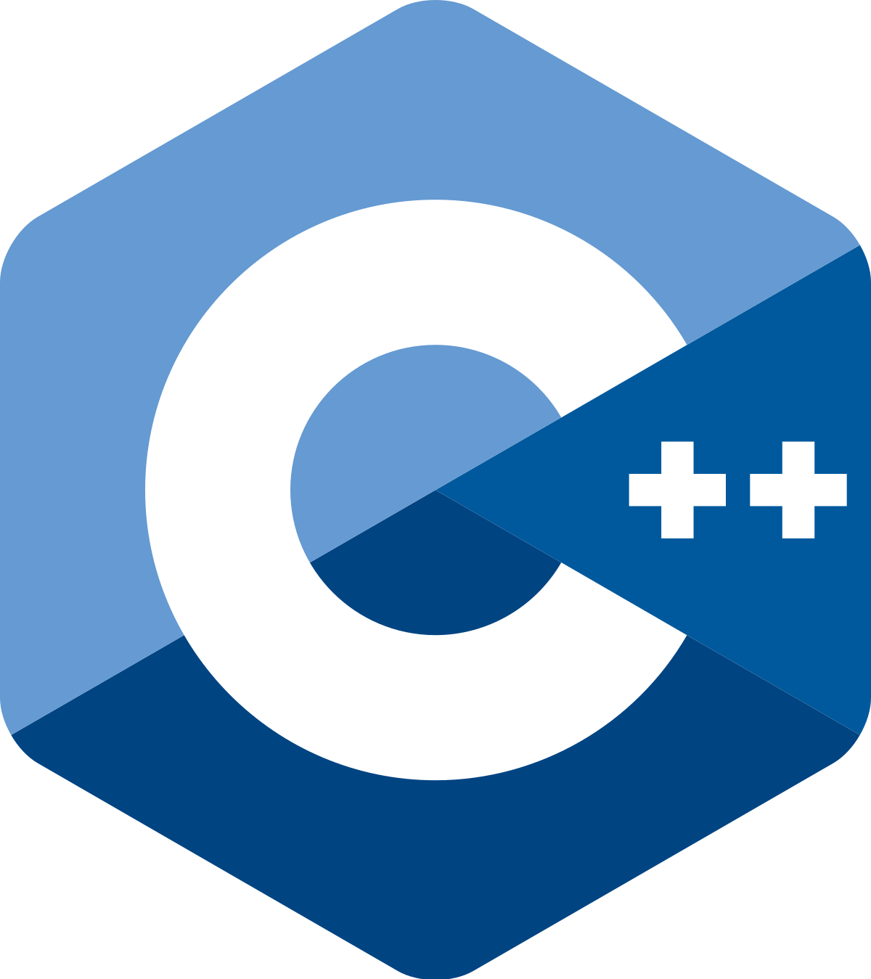





Programming Languages
There are bunch of programming languages available.
Now the question is why there are so many Programming Languages?
The purpose of different programming languages are different.
For example:
R, Juila, Matlab are used for scientific computations, where R is specifically used for statistical computations.
C, C++, JAVA, Python are General Purpose Programming Language
HTML, CSS, Javascript are used for building websites.
Python

Slide 9
What is an Algorithm?
Before jumping into learning the programming language of our choice let’s first understand what is an algorithm.
An Algorithm is defined as a sequence of well defined steps which aims to provide a solution to a specific problem using computer.
An algorithm is problem specific, however a problem can have multiple algorithms.
Algorithms are represented using Natural Languages like English or using Flowcharts or using Pseudo-Codes.
Example: Take input of two numbers and print their sum.
In plain English:
Take the Input of First Number and store it in A
Take the Input of Second Number and store it in B
Compute A+B and store it in C
Print the value of C
Flowchart:
Start
In Pseudo-Code:
Begin
A = Input(“Enter first number: “)
B = Input(“Enter second number: “)
C = A+B
Print (C)
End
Input A and B
C = A+B
Print C
Stop

Slide 10
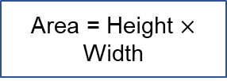
Flowchart
Flowchart is the pictorial representation of the step by step procedure (or algorithm)
There are multiple shapes used to create a Flowchart. Each shape defines a specific purpose.
Start / Stop
Example: Take input of Height and Width of a rectangle and print Area
Start
Input / Output
Input Height and Width
Processing
Decision
Area = Height $×$ Width
Flow Arrow
Storage (Data)
Print Area
Documents (File)
Stop

Slide 11
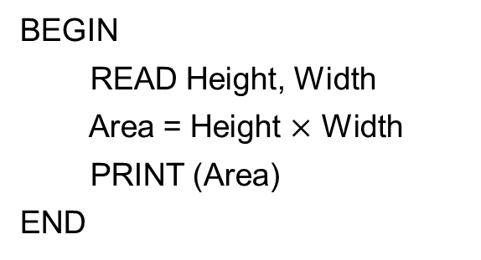
Pseudo-Code
Though Flowcharts are great visual tool to describe an Algorithm, they become very complicated when the algorithm is lengthy.
Complicated programs are often modularized into functions or sub-routines, each function doing a specific task. Describing those functions using Flowchart is cumbersome.
Pseudo-Codes are written in the form of a high level programming language (like C or Python) and provides an excellent way to write algorithm without writing an actual program (hence the name pseudo-code).
Though a Pseudo-code structurally resembles a high level programming language, they may not be a working code because we don’t exactly follow all the syntactical details of a programming language while writing pseudo-code.
Example: Take input of Height and Width of a rectangle and print Area.
BEGIN
READ Height, Width
Area = Height $×$ Width
PRINT (Area)
END

Slide 12
Decision Making
In Flowchart
Example: Given a number check whether it is even or Odd
Previous Code block
Start
Code Block to execute when the Condition is not met
Input N
Check Condition
No
N%2 == 0?
No
Print “ODD”
Yes
Code Block to execute when the Condition is met
Yes
Print “EVEN”
Stop
In Pseudo-Code
BEGIN
READ N
IF N % 2 == 0:
PRINT “Even”
ELSE:
PRINT “Odd”
END IF
END
IF (Condition):
Codes to execute when the Condition is met
ELSE:
Codes to execute when the Condition is not met
END IF

Slide 13
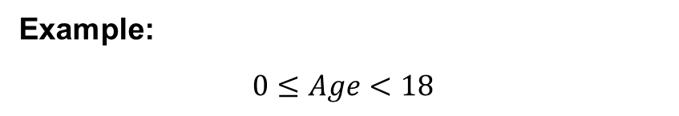

Decision Making: Multiple Conditions
Each condition returns a Boolean Value. It is TRUE if the condition is met else it is FALSE.
Multiple Conditions can be suitably combined using AND / OR clause.
AND Conditions
OR Conditions
The usual form of AND condition is following:
Condition1 AND Condition2 AND Condition3 AND …
The usual form of OR condition is following:
Condition1 OR Condition2 OR Condition3 OR …
When all the conditions are TRUE then only the expression is TRUE.
If any one of the conditions is TRUE then the whole expression is TRUE.
Example:
$$0≤Age<18$$
Example:
Vowel if the Letter is A, E, I, O, U
Age is $≥$ 0 AND Age is $<$ 18
Letter == ‘A’ OR Letter == ‘E’ OR Letter == ‘I’ OR Letter == ‘O’ OR Letter == ‘U’
There can be combination of AND / OR in a clause.

Slide 14
Decision Making: Multiple Decisions
In Flowchart
In Pseudo-Code
Previous Code Block
IF (Condition-1):
Codes to execute when Condition-1 is met
ELSE IF (Condition-2):
Codes to execute when Condition-2 is met
ELSE IF (Condition-3):
Codes to execute when Condition-3 is met
ELSE:
Codes to execute when no conditions met
END IF
END IF
END IF
Check Condition1
Yes
Code Block to execute when Condition1 is met
No
Check Condition2
Yes
Code Block to execute when Condition2 is met
No
Check Condition3
Yes
Code Block to execute when Condition3 is met
No
This is also called nested IF-ELSE blocks.
Code Block to execute when No Condition is met

Slide 15
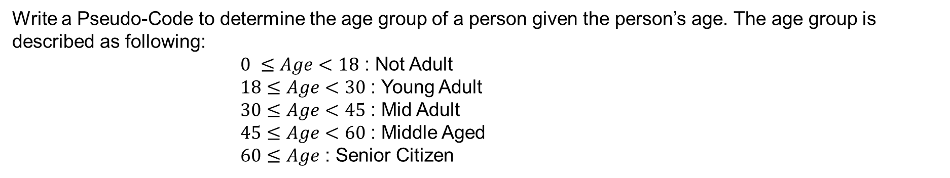
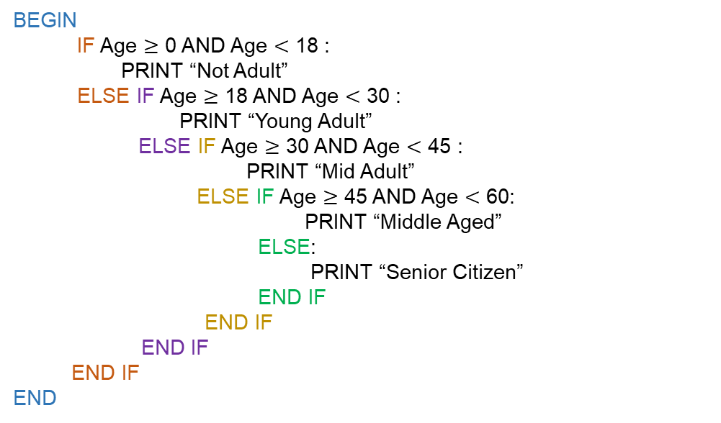
Decision Making: An Example
Write a Pseudo-Code to determine the age group of a person given the person’s age. The age group is described as following:
$0 ≤Age<18$ : Not Adult
$18≤Age<30$ : Young Adult
$30≤Age<45$ : Mid Adult
$45≤Age<60$ : Middle Aged
$60≤Age$ : Senior Citizen
The Pseudo-code looks like following:
BEGIN
IF Age $≥$ 0 AND Age $<$ 18 :
PRINT “Not Adult”
ELSE IF Age $≥$ 18 AND Age $<$ 30 :
PRINT “Young Adult”
ELSE IF Age $≥$ 30 AND Age $<$ 45 :
PRINT “Mid Adult”
ELSE IF Age $≥$ 45 AND Age $<$ 60:
PRINT “Middle Aged”
ELSE:
PRINT “Senior Citizen”
END IF
END IF
END IF
END IF
END

Slide 16

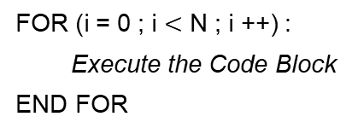


Looping
Looping is fundamentally very important concept of Programming. It comes very handy when we have to perform repetitive tasks.
There are usually two types of Looping that programmers use. While Loop and For Loop.
While Loop executes a code block if the condition is met. After execution of the code block the condition is again checked, if that’s still true it will execute the code block under it else it will break from the loop.
For Loop makes use of a counter and executes the code block under it for predefined number of times.
Counter $i =0$
$$i<N$$
No
Check Condition
No
Yes
Yes
Execute the code block
Break from the loop and Execute other code block
Break from the loop and Execute other code Block
Execute the code Block
Counter $i =i+1$
WHILE (Condition):
Execute the Code Block
END WHILE
FOR (i = 0 ; i $<$ N ; i ++) :
Execute the Code Block
END FOR
FOR i FROM 0 to N-1:
Execute the Code Block
END FOR

Slide 17
Looping
Let’s take a very Lucid example:
Print your name for given number of times.
BEGIN
FOR i FROM 0 TO N-1:
PRINT (My Name)
END FOR
END
Start
Input N
i = 0
BEGIN
i = 0
WHILE (i < N):
PRINT (My Name)
i = i + 1
END WHILE
END
i < N
No
Yes
Print (My Name)
i = i+1
Stop

Slide 18
Loop Control Statements
BREAK Statement
Sometimes we can use BREAK statement to break out of the loop if certain condition is met.
Consider the Example: Write a Program that allows user to input integer until he/she enters a negative number
BEGIN
WHILE (TRUE):
READ N
IF (N < 0):
BREAK
END IF
END WHILE
END
WHILE (TRUE): The condition inside the While statement has kept TRUE. This must be accompanied with a BREAK statement, else it will continue to run. This is also called Infinite loop.
After executing the BREAK statement the program will break from the loop

Slide 19
Loop Control Statements
CONTINUE Statement
The basic structure of CONTINUE statement is described in the following flowchart.
WHILE (CONDITION)
Some Codes
IF (CONDITION):
CONTINUE
END IF
Execute some codes
END WHILE
After encountering this CONTINUE statement the program flow goes back to the Beginning of the loop without executing the rest of the code in the loop.
Example: Print all the odd numbers between 0 to 20
BEGIN
FOR i FROM 0 TO 20:
IF i % 2 == 0:
CONTINUE
ELSE:
PRINT i
END IF
END FOR
END

Slide 20
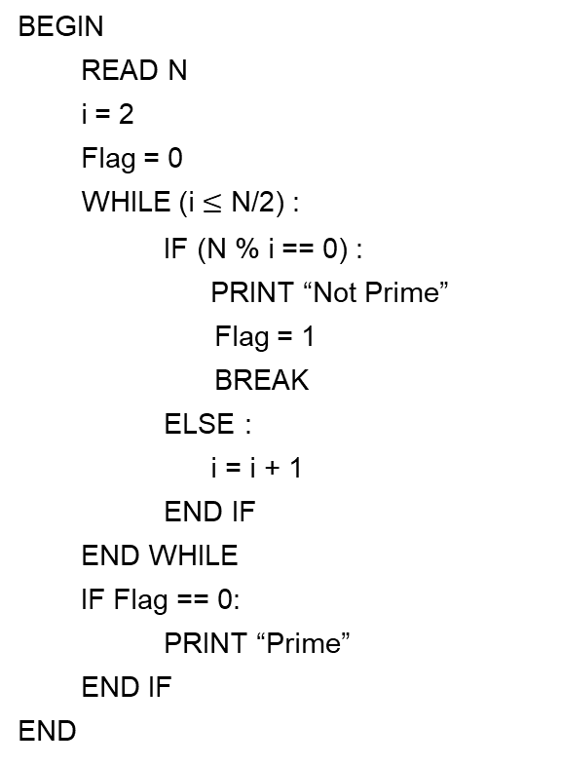
Looping
Let’s take a another example: Given a number check whether it is Prime number or not. (A number is a Prime number if it is divisible only by 1 and that number)
Intuition: Given the number N, we have to check all the numbers till N/2 whether any of them divides N.
BEGIN
READ N
i = 2
Flag = 0
WHILE (i $≤$ N/2) :
IF (N % i == 0) :
PRINT “Not Prime”
Flag = 1
BREAK
ELSE :
i = i + 1
END IF
END WHILE
IF Flag == 0:
PRINT “Prime”
END IF
END
Here Flag is a variable whose status gives the indication whether the number is prime or not.
First we have initialized Flag with 0
It is set to 1 if the number is not prime
It remains 0 if the number is prime
Finally we check the condition of the Flag to check if the number is Prime

Slide 21
Functions
Complicated Programs are often modularized into functions. Now lets see how this function works.
FUNCTION functionName (Arg1, Arg2, …):
Codes inside Function block
RETURN Some Value or Output
END FUNCTION
Each function Begins with FUNCTION key word and ends with END FUNCTION.
Each function should have a function name
Usually function provides some return value. But in some functions RETURN may not be necessary.
There are arguments of the functions. Arguments are nothing but input values to the function on which the function will operate. A function may or may not have arguments.
Example: Calculate Sum of Two Numbers
Option-1
Option-2
Option-3
FUNCTION CalculateSum (Num1 , Num2):
Result = Num1 + Num2
RETURN Result
END FUNCTION
FUNCTION CalculateSum ():
READ Num1, Num2
Result = Num1 + Num2
RETURN Result
END FUNCTION
FUNCTION CalculateSum ():
READ Num1, Num2
Result = Num1 + Num2
PRINT Result
END FUNCTION

Slide 22
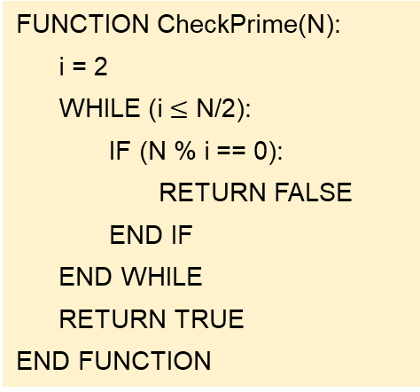
Functions
Print all the prime numbers between 2 to 100
FUNCTION CheckPrime(N):
i = 2
WHILE (i $≤$ N/2):
IF (N % i == 0):
RETURN FALSE
END IF
END WHILE
RETURN TRUE
END FUNCTION
When the function CheckPrime(k) is called within the main program, the function executes with value N = k.
When this RETURN statement is executed the flow of the program goes back to the main program with RETURN value FALSE
After the complete execution of the WHILE loop if we found no number that divides N, we return TRUE (indicating that the number is Prime)
BEGIN
FOR k FROM 2 TO 100:
p = CheckPrime(k)
IF (p == TRUE):
PRINT(k)
END IF
END FOR
END
The main program calls the function CheckPrime()

Slide 23
Arrays
Arrays are series of numbers stored consecutively.
These numbers are referred using the name of the array and index (the position where the number is stored)
Arr
2 | 14 | -36 | 75 | 1 | 89 | 22 | -12
This is the name of the array
This is the first element of the array
Index = 0
This is the second element of the array
Index = 1
This is the third element of the array
Index = 2
In the languages like C, python, Java the array indexing starts from 0. There are programming languages like FORTRAN where it starts from 1. We will consider 0 based indexing throughout our course.
Index
0
1
2
3
4
5
6
7
Arr
2 | 14 | -36 | 75 | 1 | 89 | 22 | -12
Arr[0]
Arr[1]
Arr[2]
Arr[3]
Arr[4]
Arr[5]
Arr[6]
Arr[7]
If we give index more than 7 then it will result in an error.

Slide 24
Arrays
2 | 14 | -36 | 75 | 1 | 89 | 22 | -12
Length of the Array
It is the total number of elements an array contains. In the example above there are total 8 elements in the array and the length of the array is 8.
In Pseudo Code we write length of the array as LEN(Arr)
The index of the array runs from 0 to LEN(Arr)-1
Example: Write a program to print all the values of an array
FUNCTION PrintAllValues (Arr):
FOR i FROM 0 TO LEN(Arr)-1:
PRINT (Arr[i])
END FOR
END FUNCTION

Slide 25
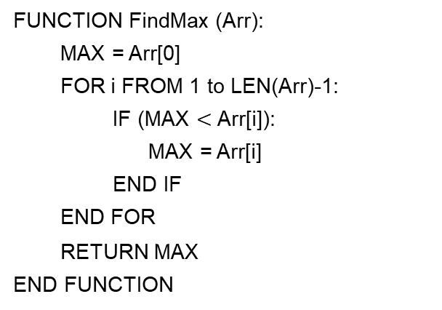
Arrays
Example: Write a program to find the max value in an array
FUNCTION FindMax (Arr):
MAX = Arr[0]
FOR i FROM 1 to LEN(Arr)-1:
IF (MAX $<$ Arr[i]):
MAX = Arr[i]
END IF
END FOR
RETURN MAX
END FUNCTION
Example: Write a program to check whether a value exist in an array. If the value exist return the index of the array else return -1.
FUNCTION SearchValue (Arr, value):
FOR i FROM 0 TO LEN(Arr)-1:
IF (Arr[i] == value):
RETURN i
END IF
END FOR
RETURN -1
END FUNCTION

Slide 26
Thank You

